Slide 1




Dig data and Facebook Challenge
Presented by Shubham Singh

Slide 2

Agenda
Best Advertising Strategy.
Best Advertising Strategy for Brand awareness.
Step to have positive response from Facebook Advertising.
Looking to other data

Slide 3


Data
The following text is a professional and short paragraph that uses the keywords: The insights are shared from the data that was collected from survey from 500 people each who saw the advertisement and 500 who were not show the advertisement and number of question based on Brand Recall, Brand Awareness and Purchase intent was asked.
The Insight focus on
1. which marketing strategy works well for Jaspers (Standard or Influencers)
2. Purchase Intent.

Slide 4
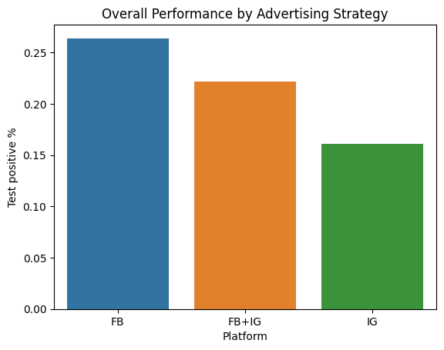
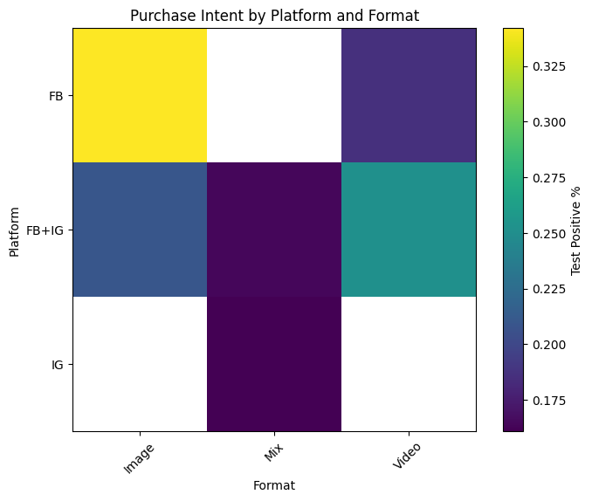
Best Advt. Strategy
Fig 01. Comparison between the Platform and Response form the Test Group
Facebook
According to the bar graph that shows the positive response rate for different advertising platforms, Facebook has the highest rate among all platforms. To find the best advertising strategy, we also need to consider the platform's relation with the desired response and the purchase intent. The correlation analysis between the format and the platform reveals that the image format on Facebook generates the highest purchase intent compared to other formats.
Fig 02.: Heatmap(Correlation) between the Format , Platform and the purchase intent

Slide 5
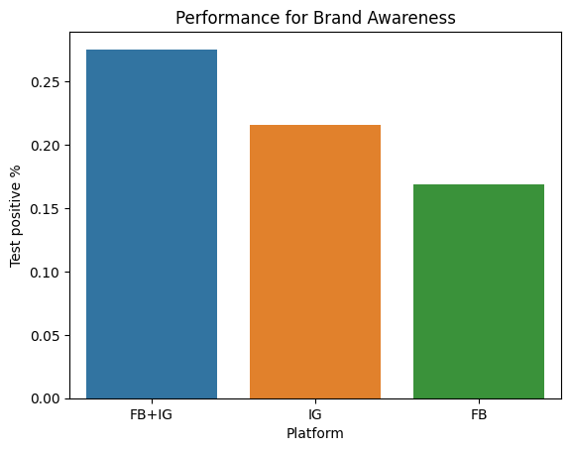
Best Advt. Strategy for Brand Awareness
Combination of Facebook and Instagram.
We use data from various digital platforms and feedback from test groups to select the optimal advertising platform for enhancing brand awareness.
Fig 03. Comparison between the Platform and brand awareness for the Test Positive Group

Slide 6
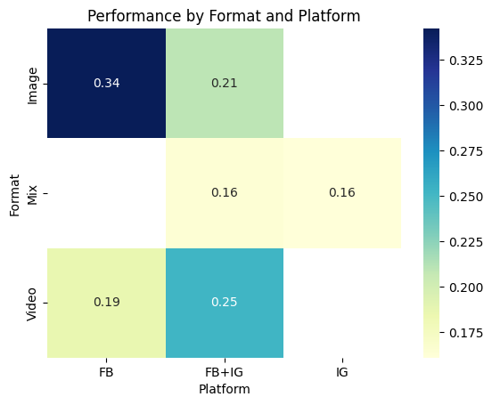
Future steps for Facebook Advt.
Use Image Format on Facebook.
The results of our analysis showed that the Test Group responded more favourably to the Image format on Facebook than to any other format or platform. Therefore, we recommend that Jasper's concentrate on producing more images for Facebook to increase their engagement and reach..
Fig 04. Comparison between the Platform and Format form the Test Group

Slide 7
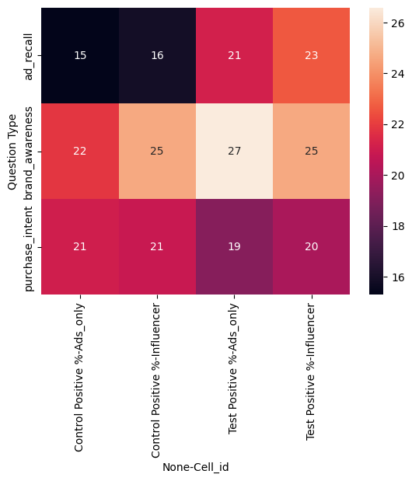
Insights from the data
Fig 05 Comparison between all the input data
Control Group was having high Purchase Intent.
The control group showed high Purchase Intent, suggesting that the website and the word of mouth publicity are effective. Standard advertisement achieved high Brand Awareness among the target audience.

Slide 8
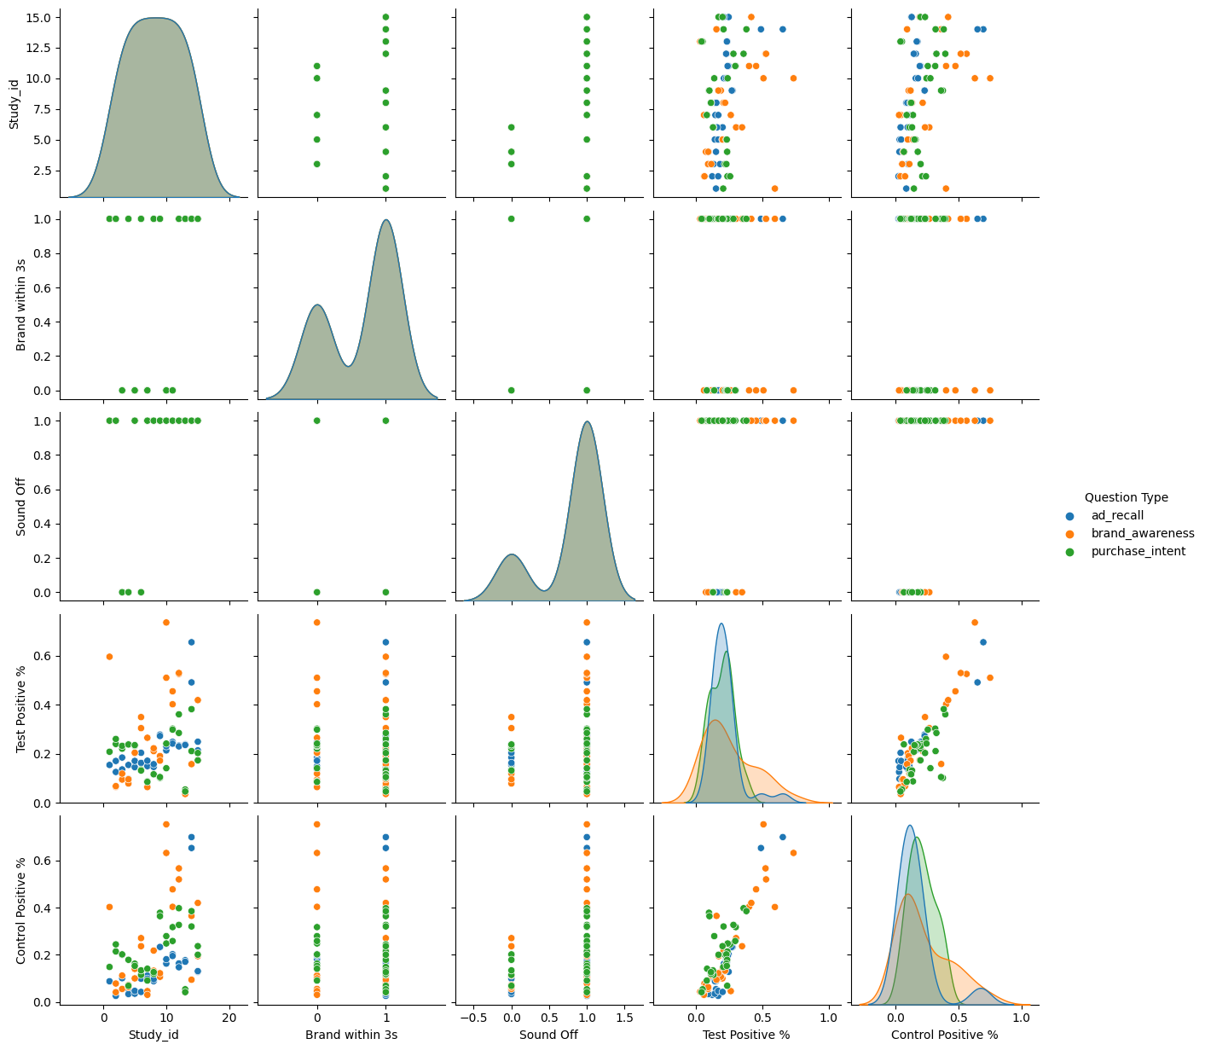
Insights from the data
From survey it was clear that people were able to recall Jasper’s Advertisement in the last 02 days.
Purchase Intent was also high from the advertisement.
Fig 06. Comparison between the numerical data wrt Question Type.

Slide 9
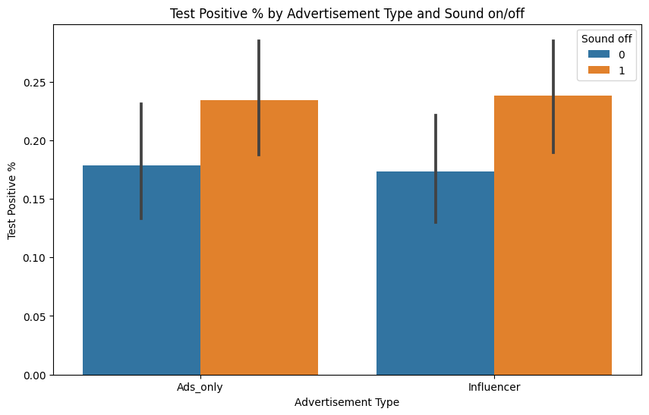
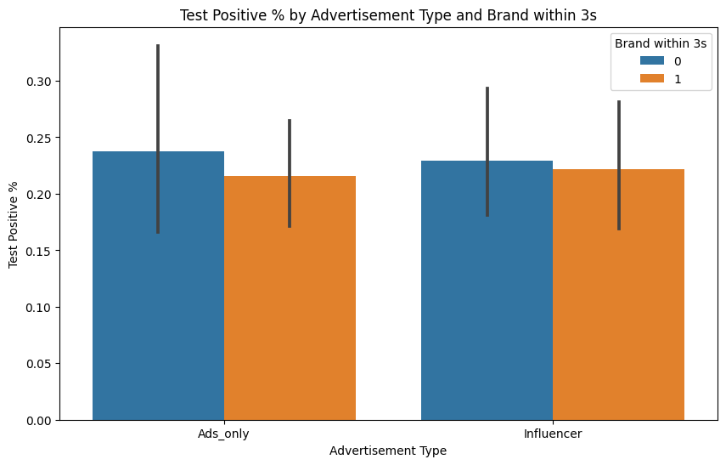
Insights from the data
Fig 07. Understanding the Sound on/off relationship with Advertisement type and Test Group response.
The Bar Chart shows how the Test Positive Group reacted to the presence or absence of Sound and Brand in the first 3 seconds of different Advertisement types. The Standard Advertisement method had the highest drop-out rate when there was no Sound and no Brand in the initial 3 seconds.
Fig 08. Understanding the Brand within 3srelationship with Advertisement type and Test Group response.

